Slide 1

IST 261 (Fall 2019)
Application Development Design Studio I
Debugging in IDEA - Intro
Phil O'Connell
pxo4@psu.edu

Slide 2
Debugging is Important
Debugging lets you pause your program while it's running
Lets you accomplish tasks such as:
View (or change) contents of variables
Find where exceptions are being thrown
Determine what's slowing down your code
View the call stack
Many others

Slide 3

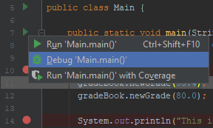
Start the Debugger
Make sure the default class is what you want
Then hit the Debug button
Or hit Shift-F9
Or Right-click on the play button in the editor

Slide 4
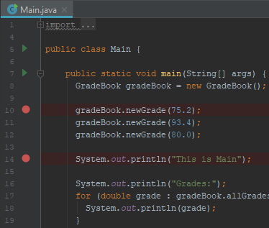
Breakpoints
Click in the left panel of the editor to choose lines to stop at when debugging
You'll see a red circle
Each of those is a breakpoint
When debugging, the code will stop at that line before the instructions are executed

Slide 5
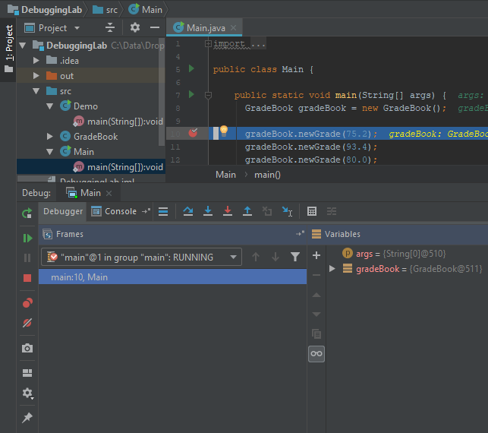
Debug Mode
Now you're running in debug mode
In the bottom pane, there are many buttons giving you runtime controls

Slide 6

Show Execution Point
Takes you to the line of code about to be executed
Helpful if you navigated to some other file, and need to return to the currently running line

Slide 7



Step Over, Step Into, Force Step Into
If you're stopped, and about to call a method, do so without going inside it
If you're stopped, and about to call a method, do so, stopping in method
Step into Java SDK classes e.g., you can see inside String.equals

Slide 8



Step Out, Drop Frame, Run to Cursor
Run the rest of the current method, and break when you return to the caller
Act as if you just entered the current method again
Whatever line your cursor is on, run until it's the execution point
Like a temporary, one-time-use, invisible breakpoint

Slide 9



Rerun, Resume, Pause
Stop running, and restart debugging
Continue running the program
Stop the code running
e.g., if you're stuck in an infinite loop, or working on time-consuming processing, or waiting for user input from the keyboard

Slide 10



Stop, View Breakpoints, Mute Breakpoints
Stop the program; end debugging
Show a list of all the breakpoints
Don't stop at the breakpoints; ignore them
But don't delete them

Slide 11
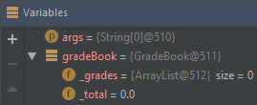

Variables in Scope
You can view and set the values of variables in scope

